Slide 1

Rocket League Rank Classifier
Tyler Eck
410821337
Machine Learning

Slide 2
Introduction
Rocket League is a vehicular soccer video game developed and published by Psyonix. Just as the sport soccer, players aim to win against the other team by scoring more goals.
There are a total of 8 main ranks a player can be: Bronze, Silver, Gold, Platinum , Diamond, Champion, Grand Champion and Supersonic Legend
Each rank has a 3 divisions and to level up from one division to another, players must win matches.

Slide 3
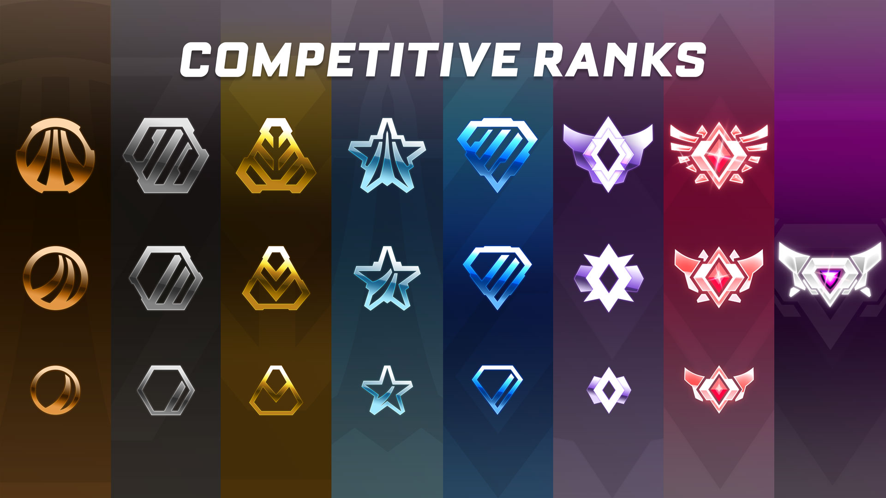
Rocket League Ranks

Slide 4
Introduction
Statistics of each player are made public on the Rocket League Tracker website: https://rocketleague.tracker.network/
Statistics for any single game mode include:
Goals/Game
Shots/Game
Saves/Game
Total # Of Matches
Shot Accuracy

Slide 5
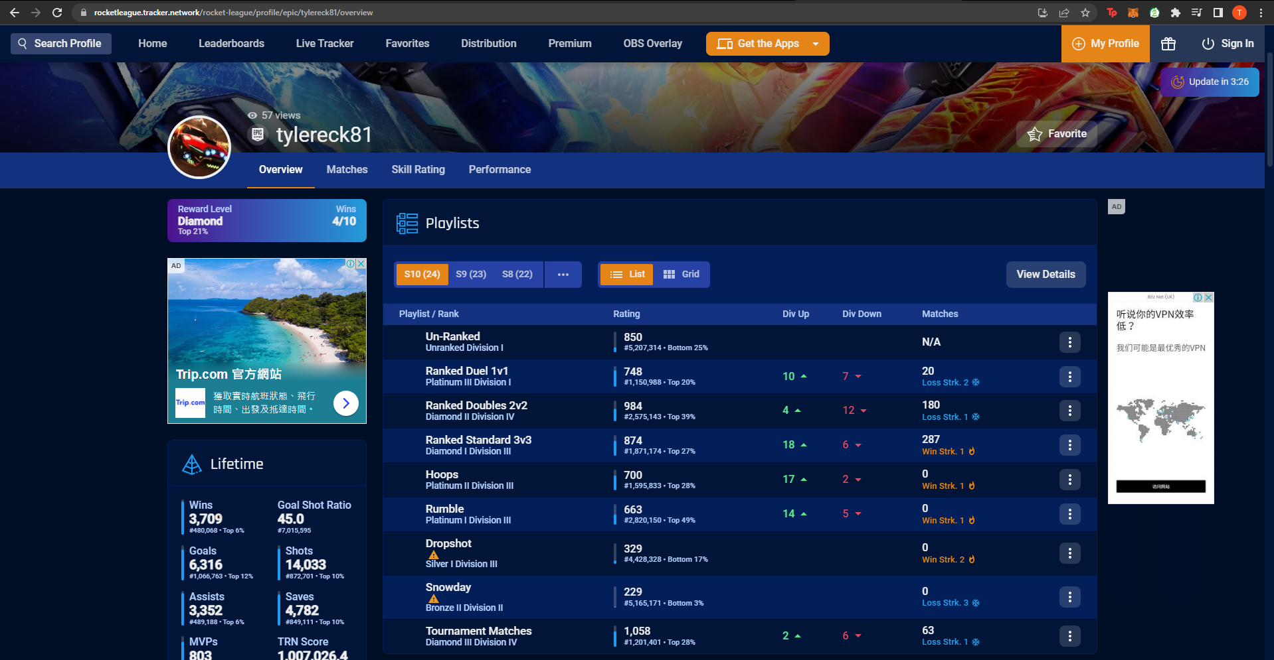

Slide 6
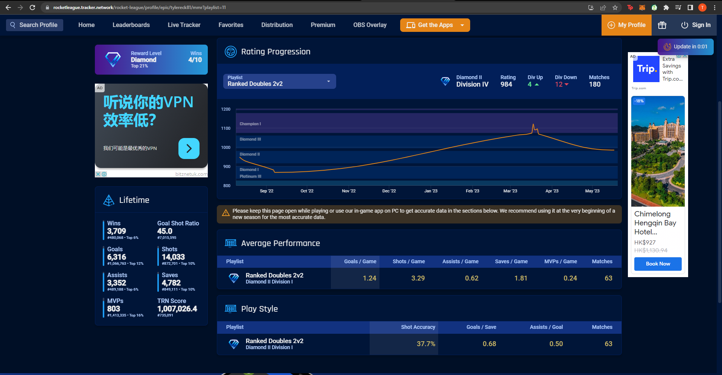

Slide 7
Objective
Because all these factors influence a player’s rank, the objective of my project is to create a Rocket League rank classifier to determine a player’s rank.
All the necessary features can be found on this website and will be used to train the ML models.

Slide 8
Motivation
Rocket League is my favorite game – I play every day with my teammates and try to get a higher rank every time.
I want to determine if we can properly classify each player based on these statistics.
I want to determine which specific characteristics (statistics) have the strongest influence on how high ranked the player is.

Slide 9
Method
Because there are multiple game modes for Rocket League (1v1, 2v2, 3v3, etc.), I decided to focus on Duel(1v1) mode.
Steps for Project:
Data Collection
Pre-processing (fixing mistakes in the data)
Training of the ML models
Testing
All code was be done using Python

Slide 10
Data Collection (First Draft)
I will only collect data from the Rocket League Tracker website
I will try to collect 100 data points(profiles) from each rank with a python script using the selenium and html_requests library
I will select the 100 profiles for each rank from the “Ranked Duel 1v1 Rating Leaderboard”

Slide 11
Problem 1
As the rank gets lower, there is less 1v1 data to scrape

Slide 12
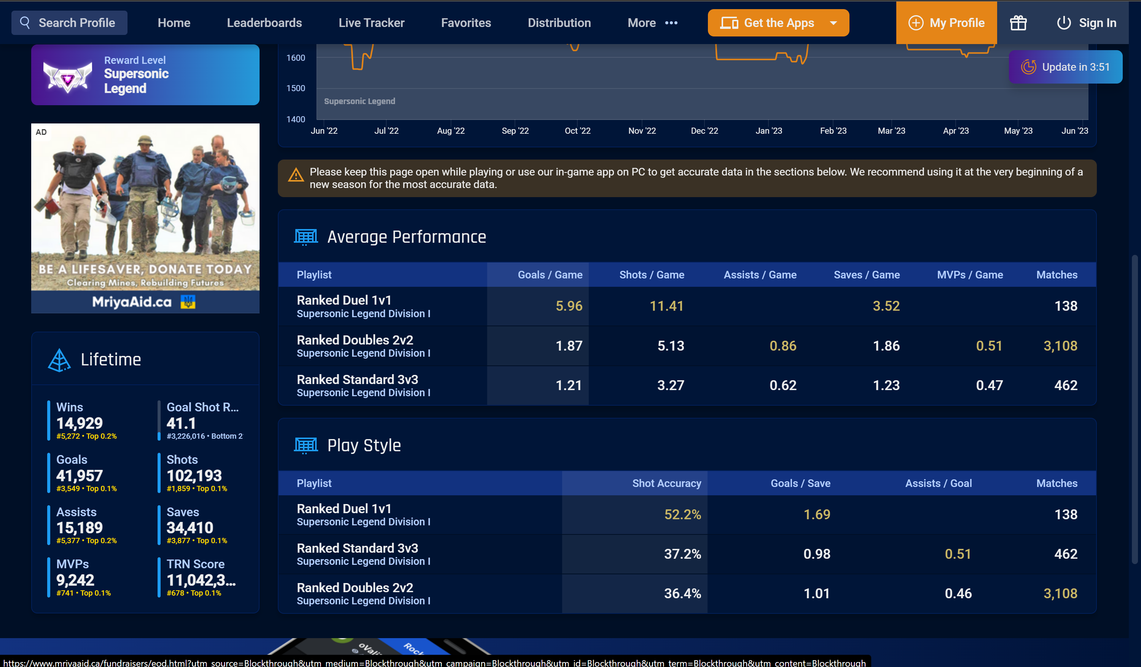

Slide 13
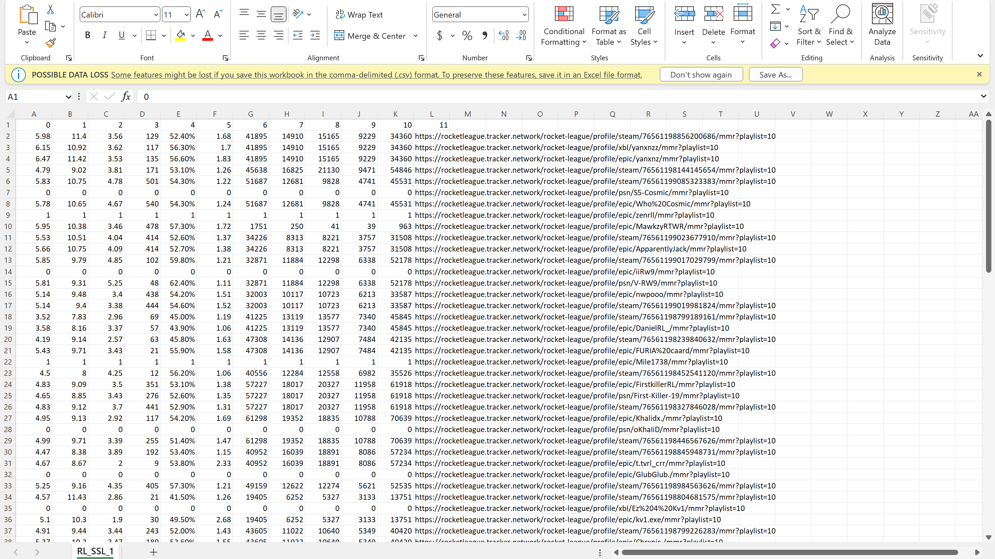

Slide 14
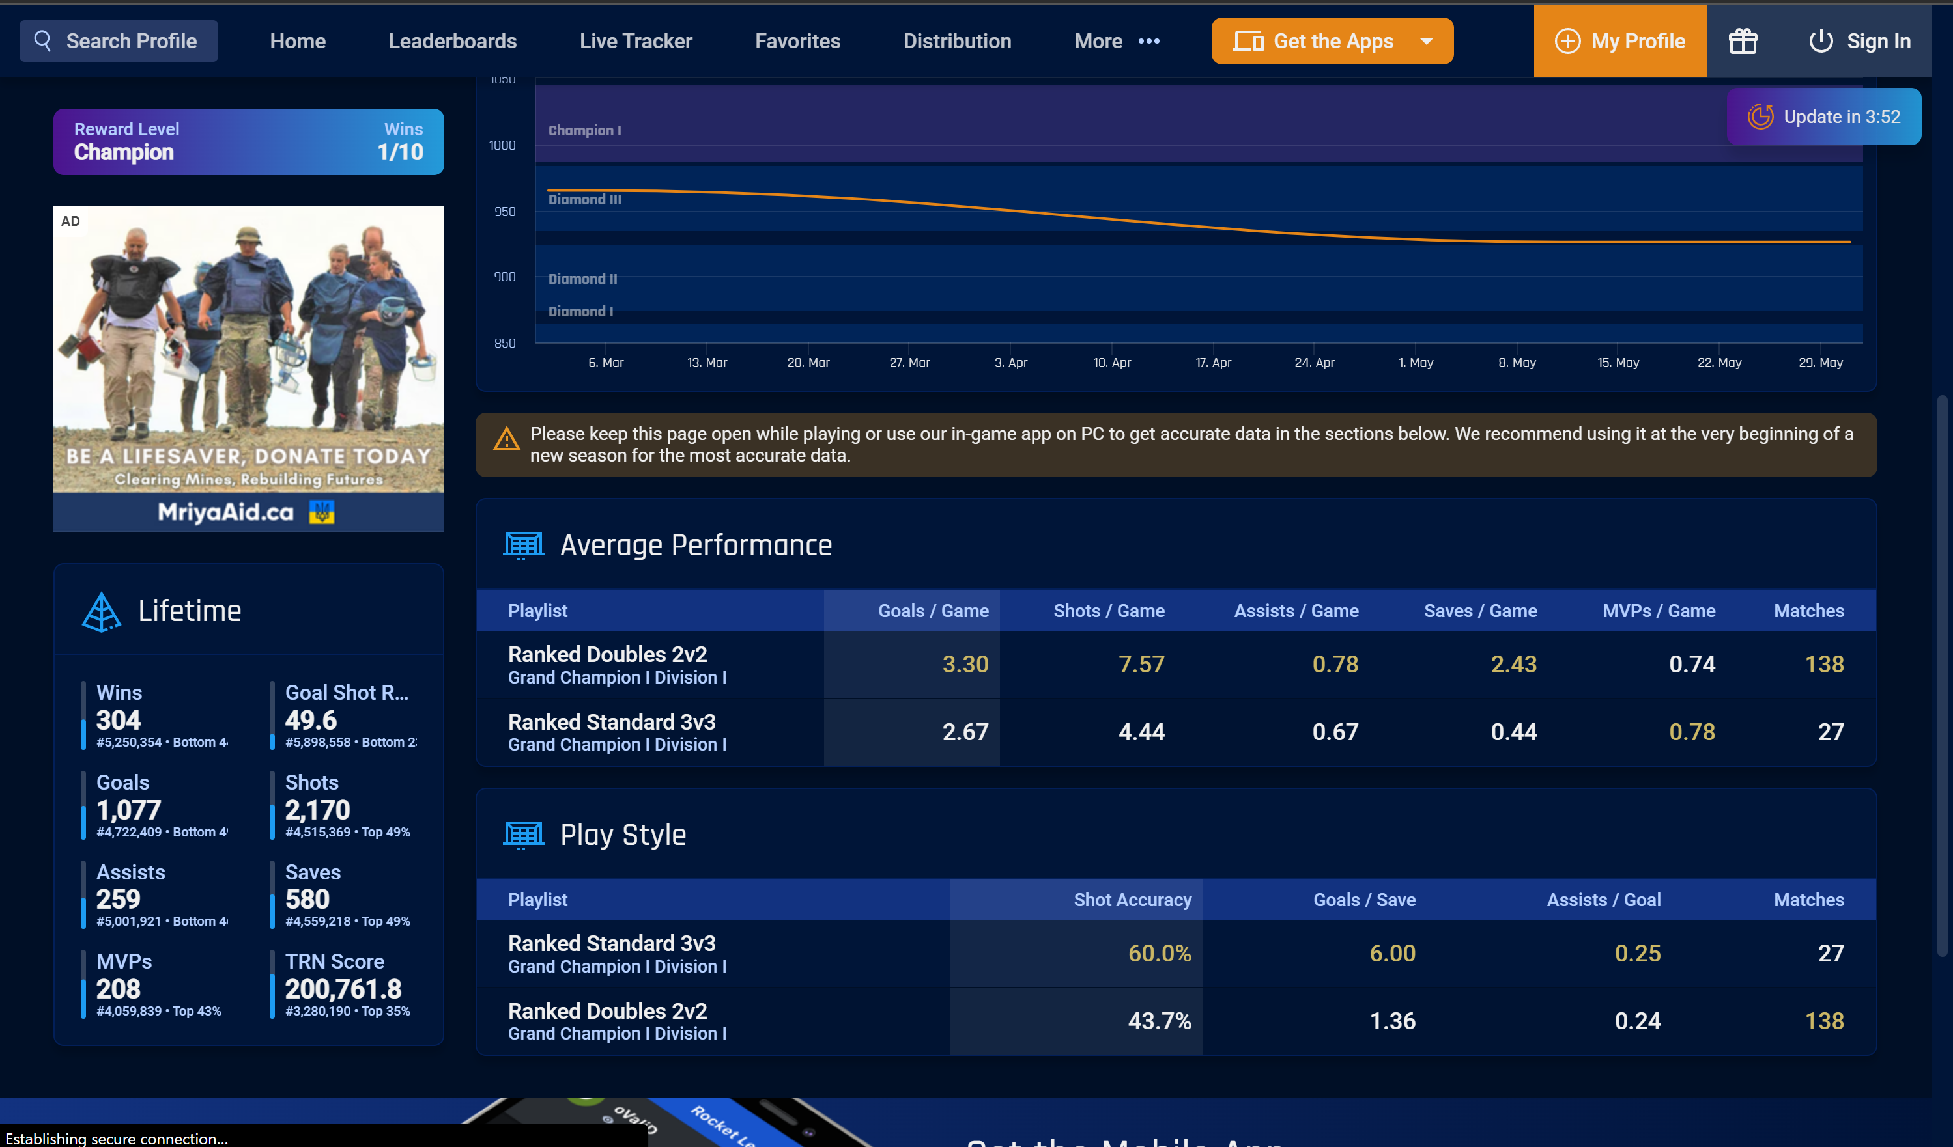

Slide 15
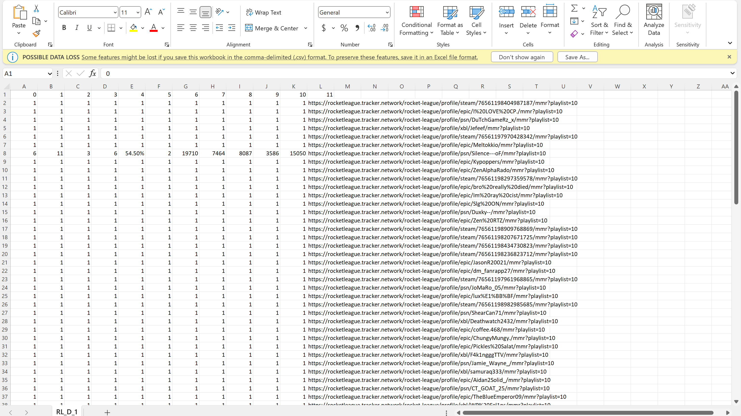

Slide 16
Data Collection (Final Draft)
I only collected data from the Rocket League Tracker website: “Ranked Duel 1v1 Rating Leaderboard”
I collected 350 data points(profiles) from each of the top 3 ranks:
SSL
Grand Champ
Champion
Used a python script using the selenium and html_requests library to acquire the 100 profile links on each page and then open each profile page, scrape the necessary data, and close the page.

Slide 17
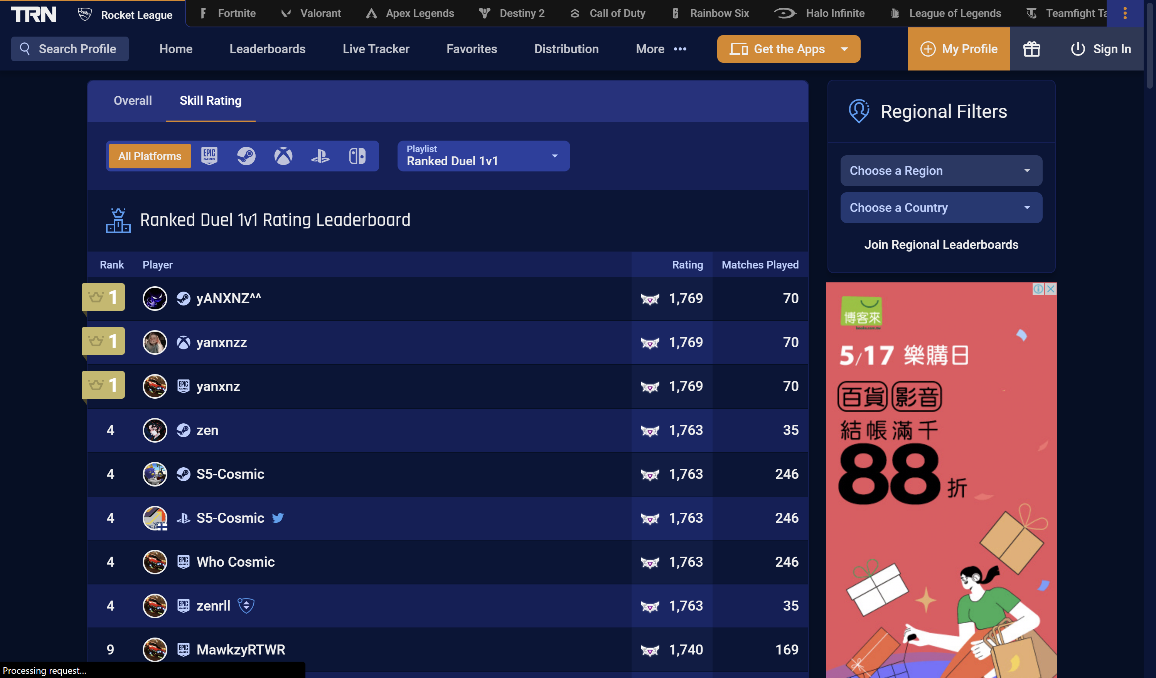

Slide 18
Data Collection (First Draft)
After getting the profiles, I will use the following 8 features for the model:
Goals/Game – goals per game
Shots/Game – shots per game
Saves/Game – saves per game
Total # Of Matches – total # of 1v1 matches played
Shot Accuracy – percentage of shots on goal
Goals/Saves- Goals to Saves Ratio
MMR- Matchmaking Rank
Actual Rank

Slide 19
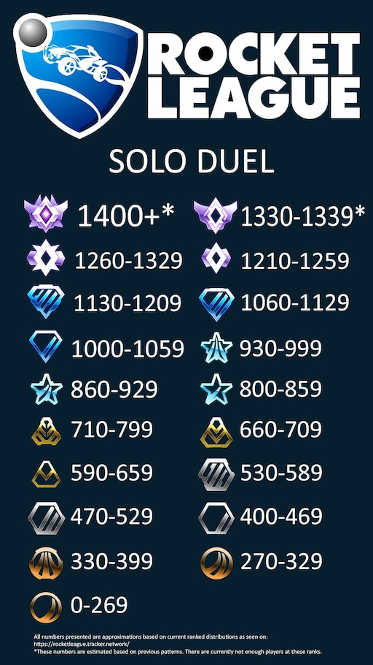
Problem 2
MMR – matchmaking rating is directly correlated with the ranks (numerical representation of a rank)
The 7 features don’t include lifetime statistics which is very limiting
(Hypothesis: More lifetime wins indicate expertise and higher rank)

Slide 20
Data Collection (Final Draft)
After getting the profiles, I will use the following 11 features for the model:
Goals/Game – goals per game
Shots/Game – shots per game
Saves/Game – saves per game
Total # Of Matches – total # of 1v1 matches played
Shot Accuracy – percentage of shots on goal
Goals/Saves- Goals to Saves Ratio
Total Goals – lifetime goals
Total Wins – lifetime wins
Total Assists – lifetime assists
Total MVP – lifetime MVP
Total Saves – lifetime saves

Slide 22
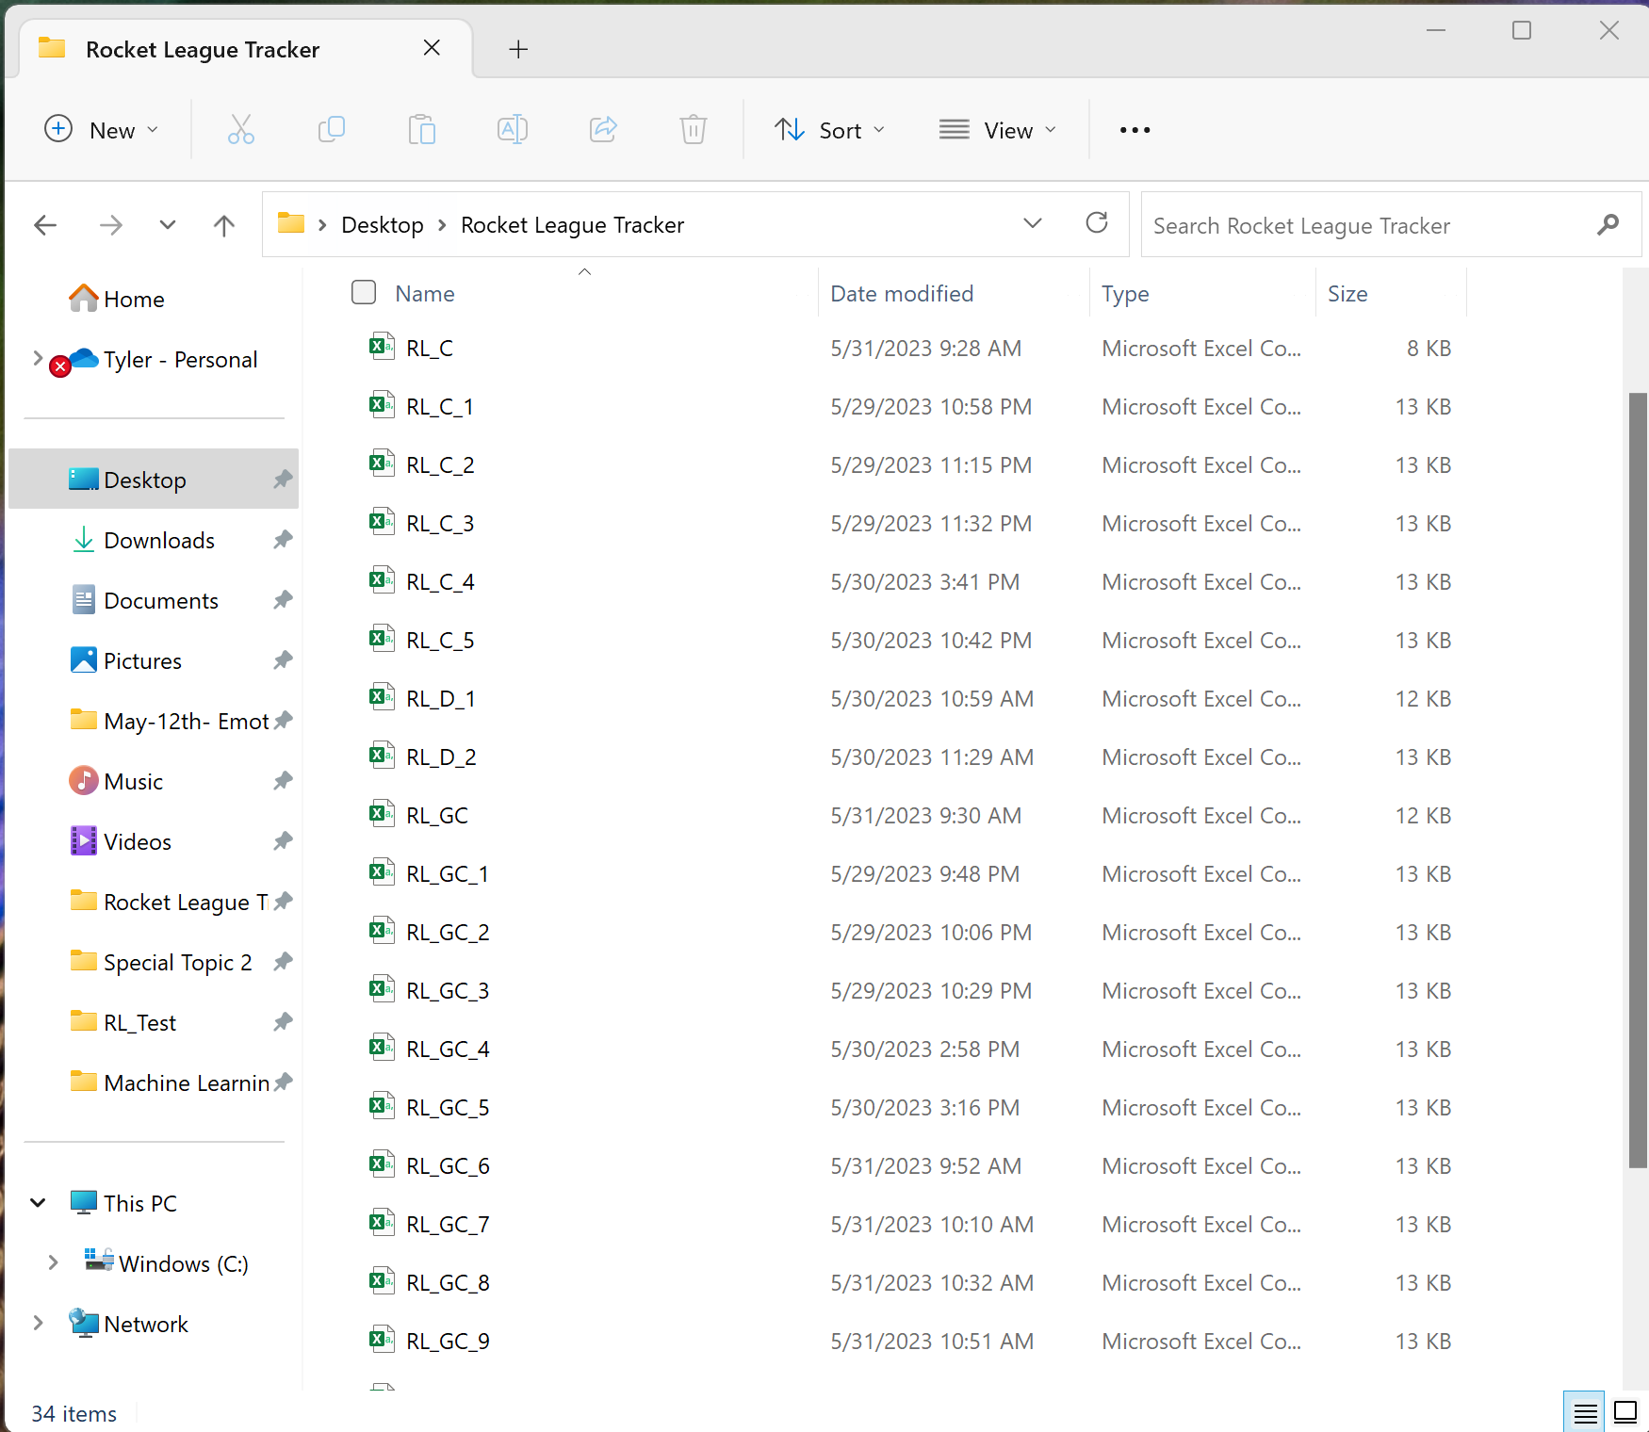
Data Collection
After I got these 11 features for each rank, I stored them in multiple csv file for the preprocessing stage

Slide 23
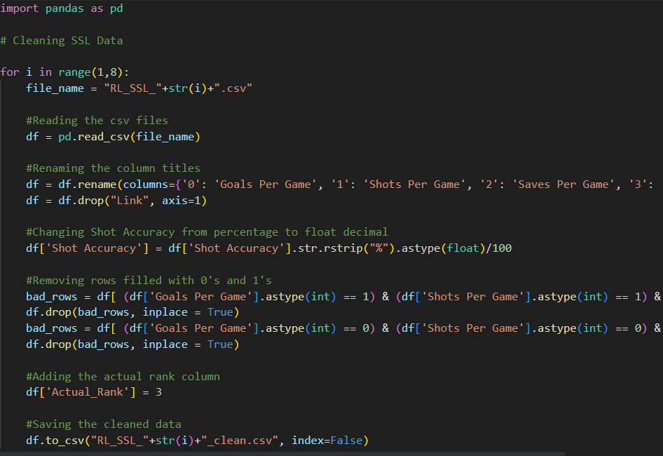
Preprocessing : Cleaning
Cleaning involves adding column titles, changing all values to “int” or “float”, removing missing data, and adding the “rank” column

Slide 24
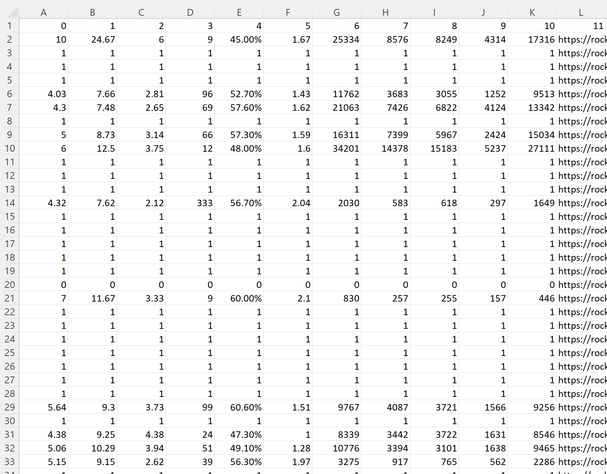
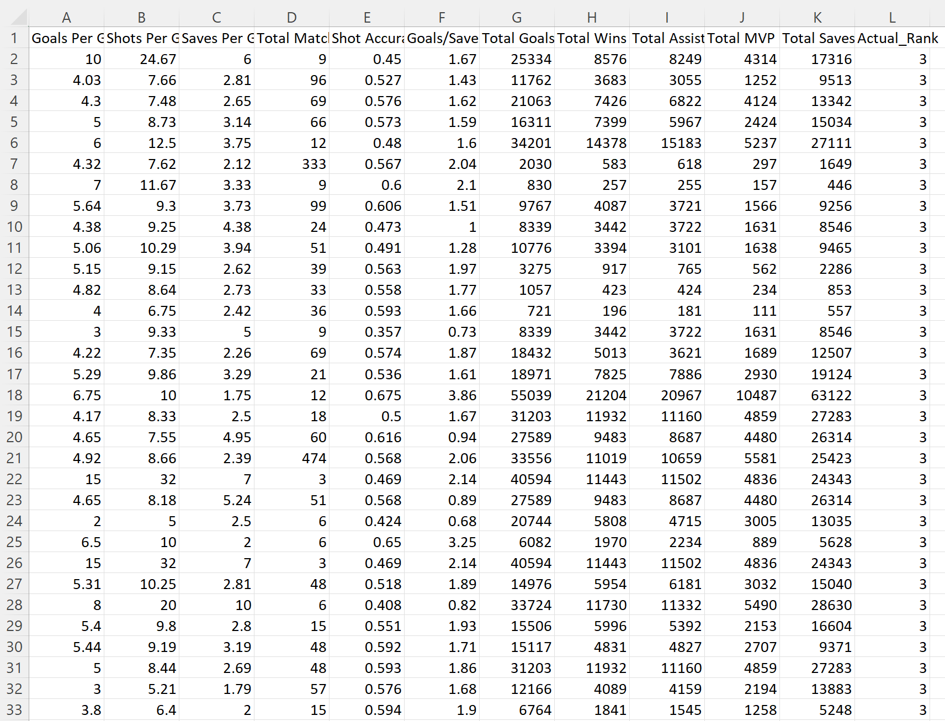
Preprocessing : Cleaning

Slide 25
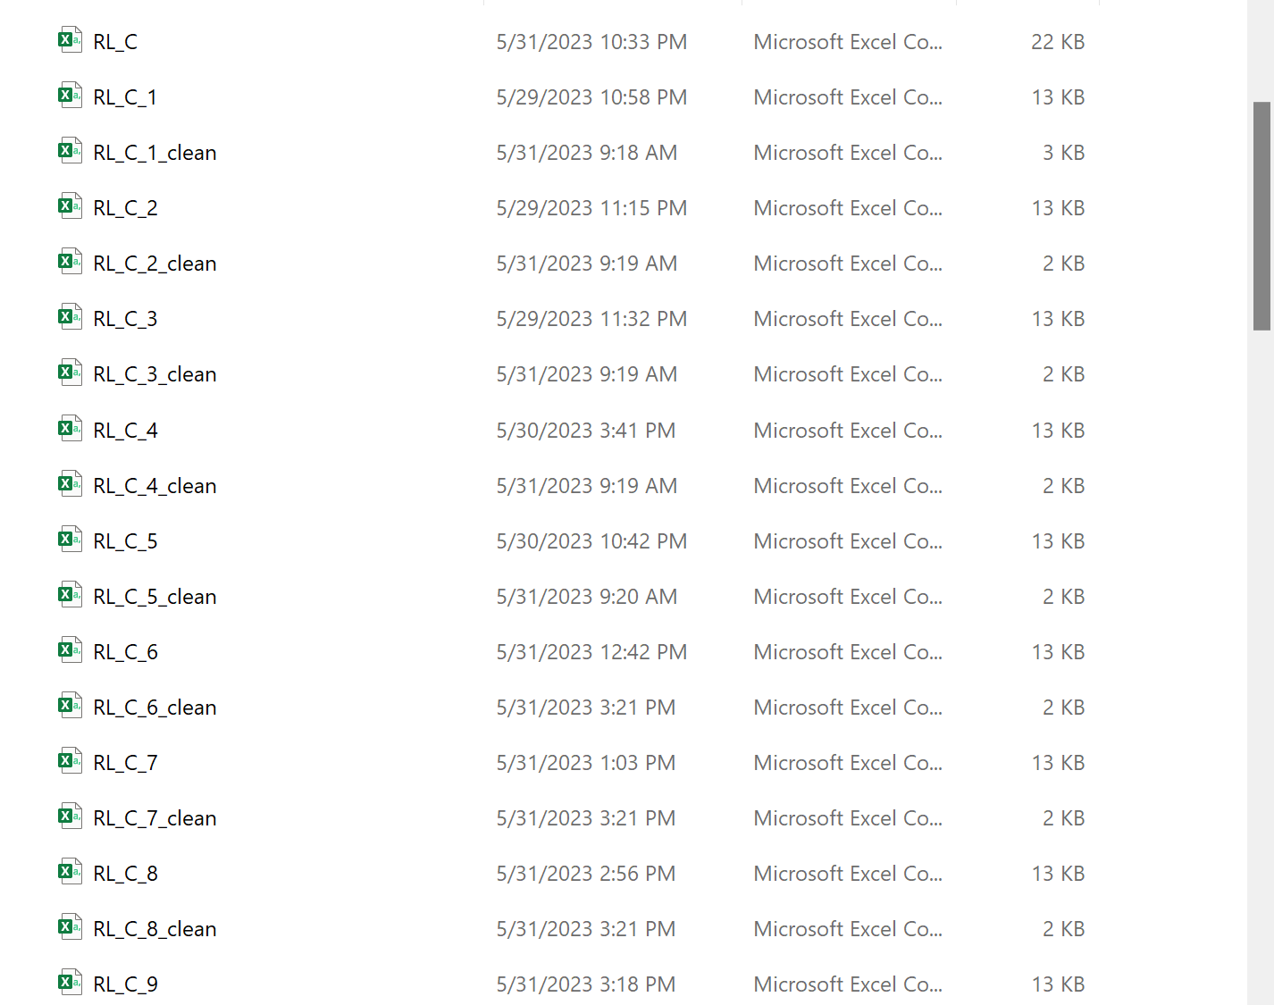
Preprocessing : Cleaning

Slide 26
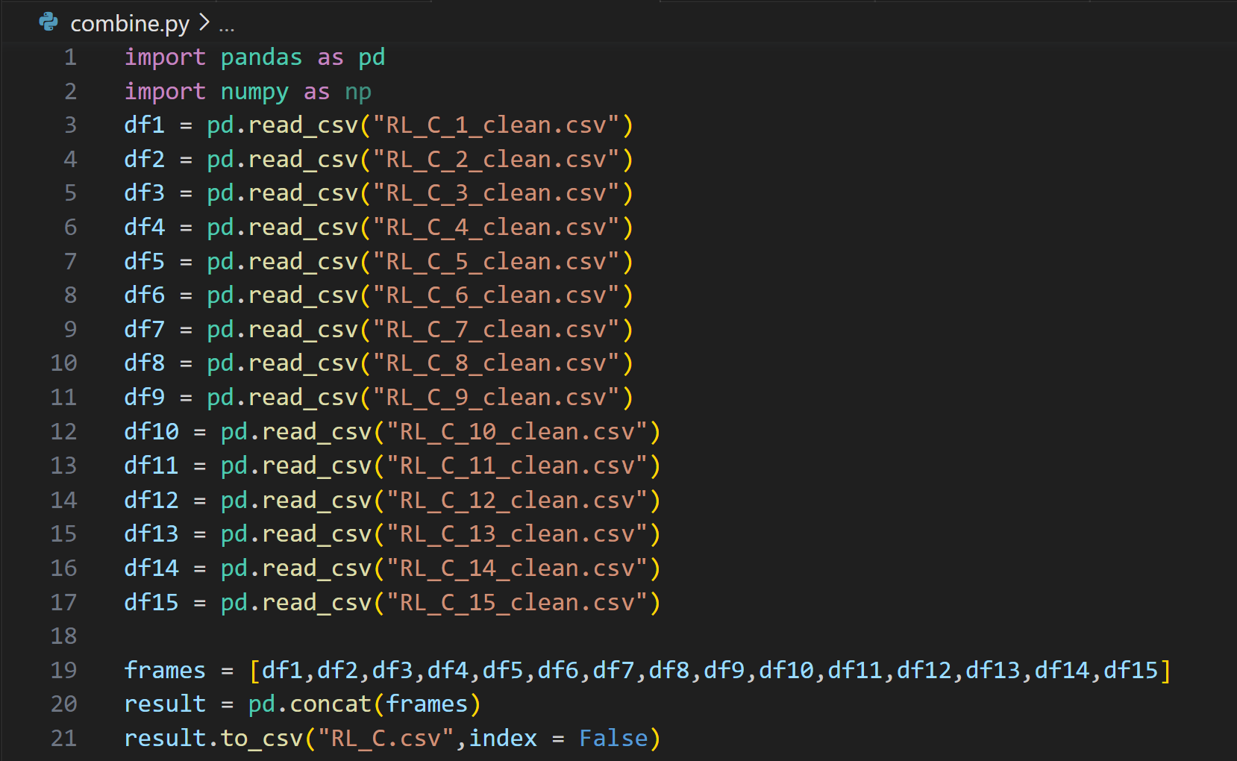
Preprocessing: Combining
Took all the clean versions of the data files and combined them into a main one

Slide 27
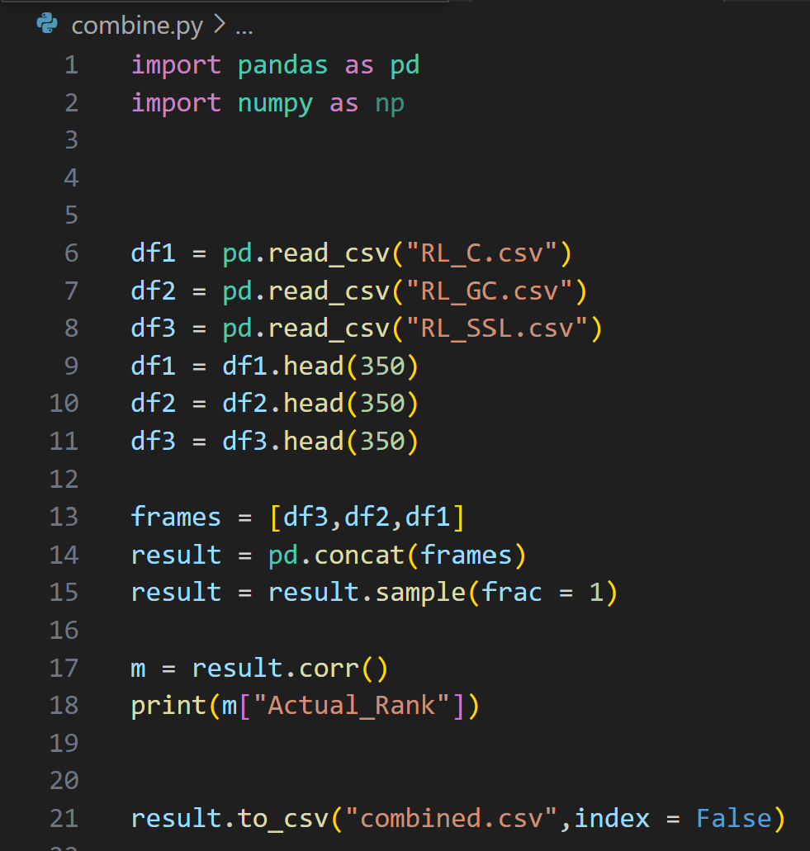
Preprocessing: Combining
Combined all rank data into one csv file

Slide 28
Training / Model Building
Supervised Learning:
Logistic Regression (LR)
Support Vector Classifier (SVC)
Random Forest (RF)
Models were imported from sklearn library in python
Data was split into Training (70%) and Testing (30%) with train_test_split from sklearn library in python

Slide 29

Training / Model Building
Ran the model with default settings and all features (DSDF)
Ran the model with default settings but selected features (DSSF)
Ran the model with specific settings and all features (SSDF)
Ran the model with specific settings and selected features (SSSF)

Slide 30
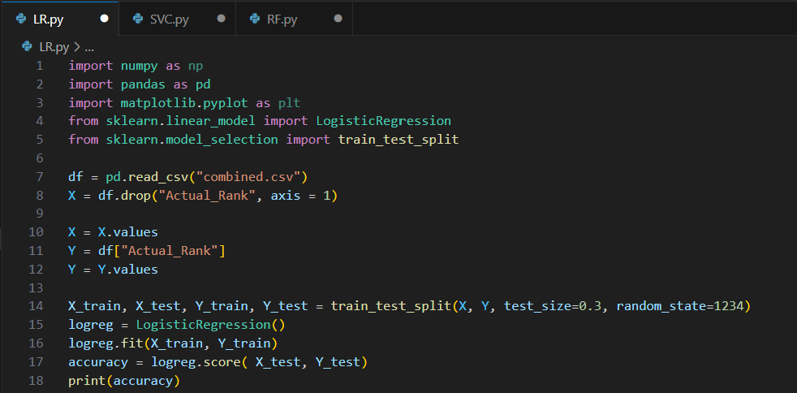
Logistic Regression

Slide 31
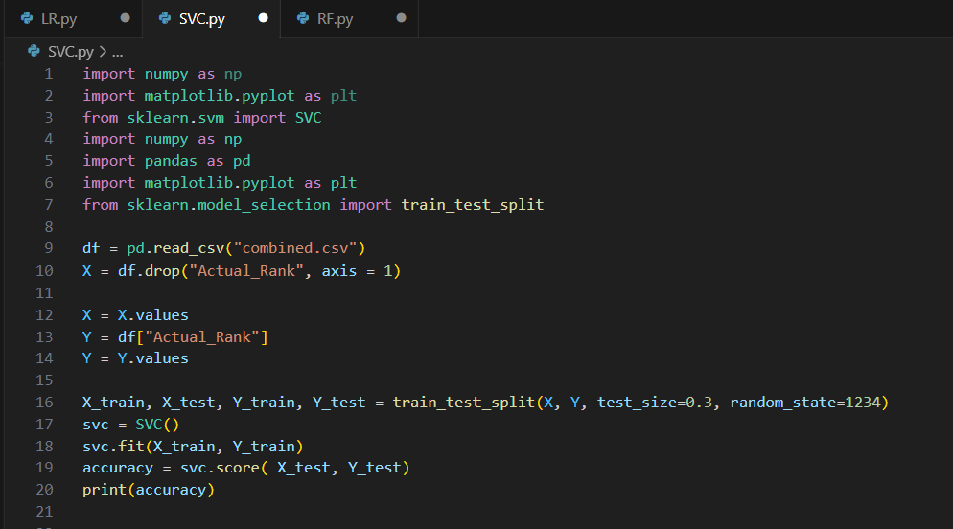
Support Vector Classifier

Slide 32
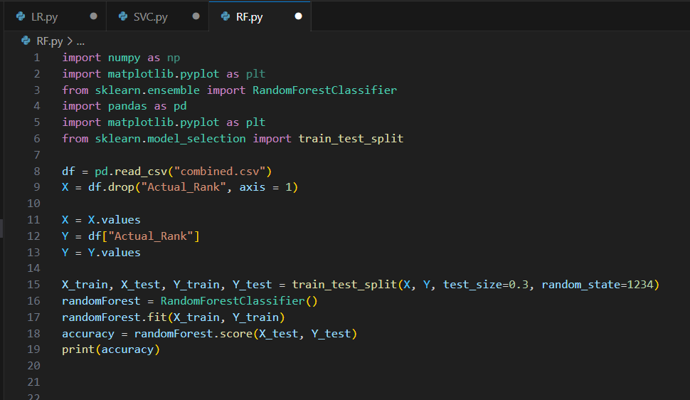
Random Forest

Slide 33
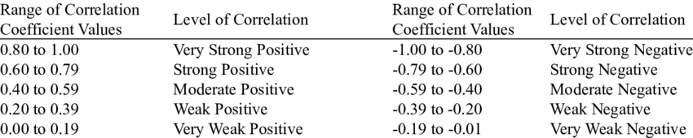
Specific Feature Selection
Correlation Matrix – a statistical technique used to evaluate the relationship between two variables in a dataset

Slide 34
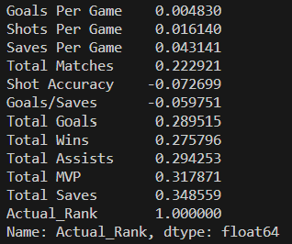
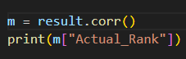
Specific Feature Selection
Pandas correlation matrix function – corr()
Dropped:
Goals Per Game
Shots Per Game
Saves Per Game
Shot Accuracy
Goals/Saves

Slide 35
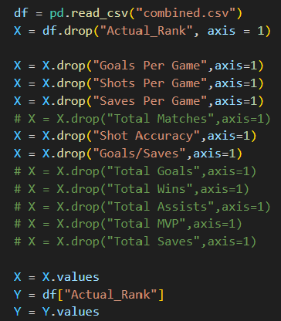

Slide 36
Specific Parameter Selection – Logistic Regression
Changed the “C” parameter
C is the regularization parameter which is a positive integer greater than 0
The value will be the inverse of the strength of regularization
- Used a for loop to find which C yields the highest result (1-300)

Slide 37
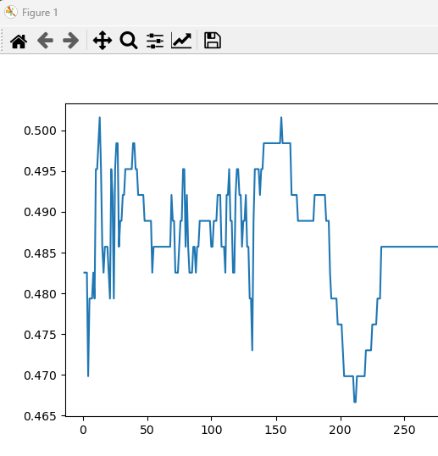
Specific Parameter Selection – Logistic Regression
Highest Accuracy:
C value: 13
Accuracy: 0.5015873015873016

Slide 38
Specific Parameter Selection – SVC
Changed the “C” parameter
C is the regularization parameter which is a positive integer greater than 0
The value will be the inverse of the strength of regularization
- Used a for loop to find which C yields the highest result (1-300)

Slide 39
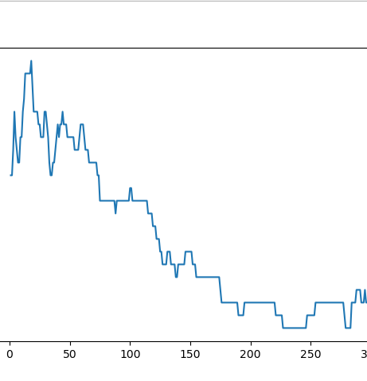
Specific Parameter Selection – SVC
Highest Accuracy:
C value: 18
Accuracy: 0.5047619047619047

Slide 40
Specific Parameter Selection – Random Forest
Changed the “n_estimators” parameter
This value specifies the number of subtrees established in the forest.
It can have a huge impact on the overall performance
- Used a for loop to find which n_estimator value yields the highest result (1-200)

Slide 41
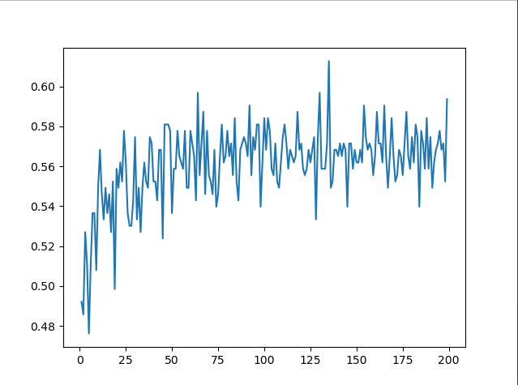
Specific Parameter Selection – Random Forest
Highest Accuracy:
N_estimator value: 135
Accuracy: 0.6126984126984127

Slide 42
Results
Model | DSDF | DSSF | SSDF | SSSF
Logistic Regression | 0.48253968253968255 | 0.473015873015873 | 0.5015873015873016 | 0.4984126984126984
SVC | 0.47619047619047616 | 0.4793650793650794 | 0.5047619047619047 | 0.4984126984126984
Random Forest | 0.5555555555555556 | 0.5619047619047619 | 0.6126984126984127 | 0.6031746031746031

Slide 43
Observations
Parameter Selection had the largest impact on all three of the models
Default Settings yielded the lowest accuracy
Random Forest gave the absolute best results
Combination of my parameter selection and feature selection produced worse results compared to just parameter selection
Lifetime results were important in producing higher accuracy

Slide 44
Analysis Why are the accuracies so low?
The data that I scraped was not enough
The data showed very low correlation with the actual rank, so there was little to no indication that it would be able to guess the rank

Slide 45
Conclusion
My objective was to determine if we can guess a player’s rank based on the statistics that I successfully scraped and cleaned.
After running the models, with default settings, selected features, specific parameters, and with both selected features and parameters, the highest accuracy I got was from Random Forest with 0.6 accuracy.
Another objective was to determine which features play the most important roles in determining a player’s rank
After using the correlation matrix, I determined that the highest feature correlation resulted from Lifetime Saves which was still a “very weak” correlation.

Slide 46
Thank you for listening!

